Slide 1
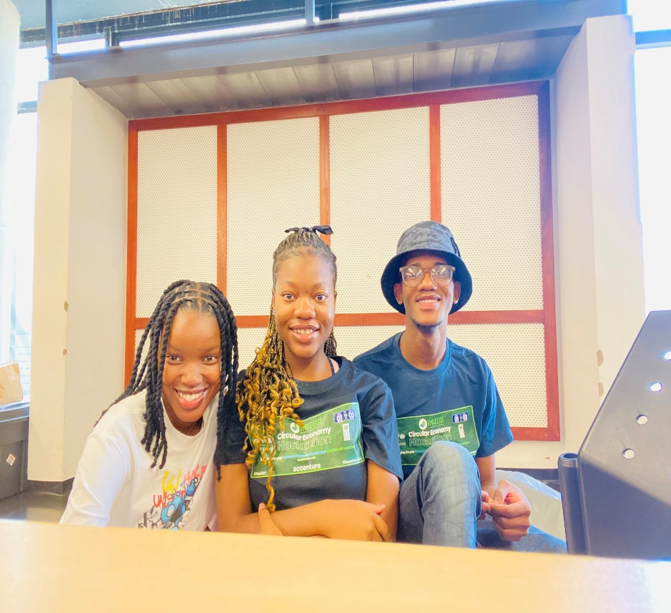
Trash Attack
TEAM MEMBERS:
Tessa Lehong
Relebogile Lebitsa
Nyaniso Tukani

Slide 2
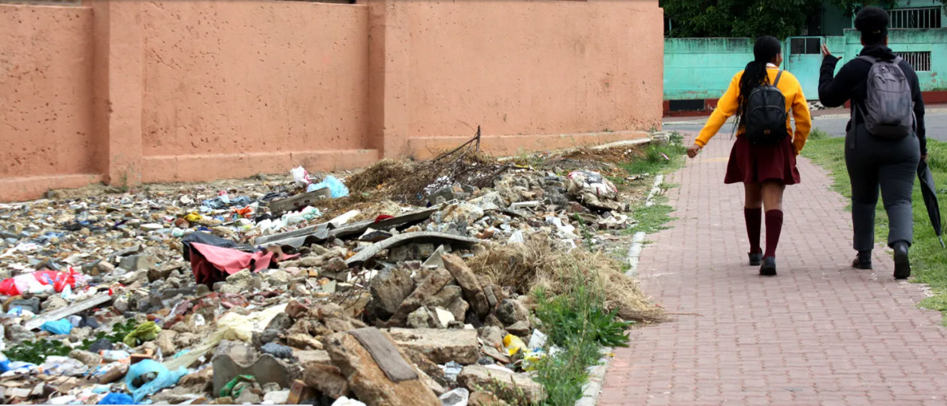
PROBLEM STATEMENT:
According to the The City of Cape Town, littering and illegal dumping remain a major challenge throughout the city.
More than 180 000 tons of waste are cleared annually from illegal dumping sites citywide. Illegal dumping costs the City R350 million annually.

Slide 3
OUR SOLUTION
We are working together with schools to tackle waste management in communities. Schools in a certain area compete by recycling waste products then Trash Attack goes and collects the waste which we sort and proceed to sell to companies that require waste e.g. Greentech technologies which uses plastics to make eco-friendly and affordable bricks . The top students who collected the most waste get prices such as goodie bags, vouchers and even school bags. We will be collaborating with a lot of organizations to make it as fun and sustainable as possible.

Slide 4
TARGET
Our target market is learners because we know how competitive kids can be . We aim to make the community cleaner in a fun way and still be able to promote a circular economy by selling to companies that require waste since they are going to reuse the material. We are using geo tagging and machine learning to validate that there is indeed a difference in the community since Trash attack was introduced. We aim to go to different townships and improve the sense of living.

Slide 5
HOW WE ARE GOING TO MAKE MONEY
By collecting the waste and sorting it we sell the waste and create eco-friendly products. We also advertise these businesses and brands that will be collaborating with us when giving away rewards and vouchers.

Slide 6
Conclusion
The aim of Trash Attack is to instill the importance of waste management and also to make competition fun and something that is a positive change , not just for the kids but for the community as a whole.
It is key that we reach the children with this message as early as possible if we want to change the culture around waste in communities where littering and dumping is a challenge. They can be agents of positive change.
-”A clean man in a dirty town is a dirty man”

